Slide 1

MBAX 6418
Serving and Debugging
David Dobolyi, PhD
Assistant Professor
Stone Family Faculty Scholar
david.dobolyi@colorado.edu

Slide 2
Topics
Building, Serving, and Sharing
Incorporating APIs
Debugging
GitHub
2

Slide 3
Building, Serving, and Sharing

Slide 4
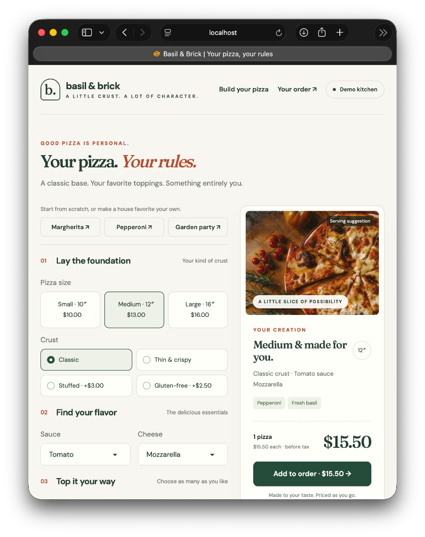

Building
Let’s create a small web app, add features (including one with AI), and share it
We’ll also commit it to GitHub for version control
Starter prompt:
  “build a python app using gradio for a pizza ordering website where customers can customize their pizzas with things like toppings, size, crust, etc.”
Made with Hermes Agent and GPT-6 Astra

Slide 5

Choosing an Interface
We have many interface options, but for Python, Gradio and Streamlit are good, high abstraction options (i.e., they handle many of the technical details for us)
Notes:
Sources:
https://gradio.app/guides/quickstart

Slide 6
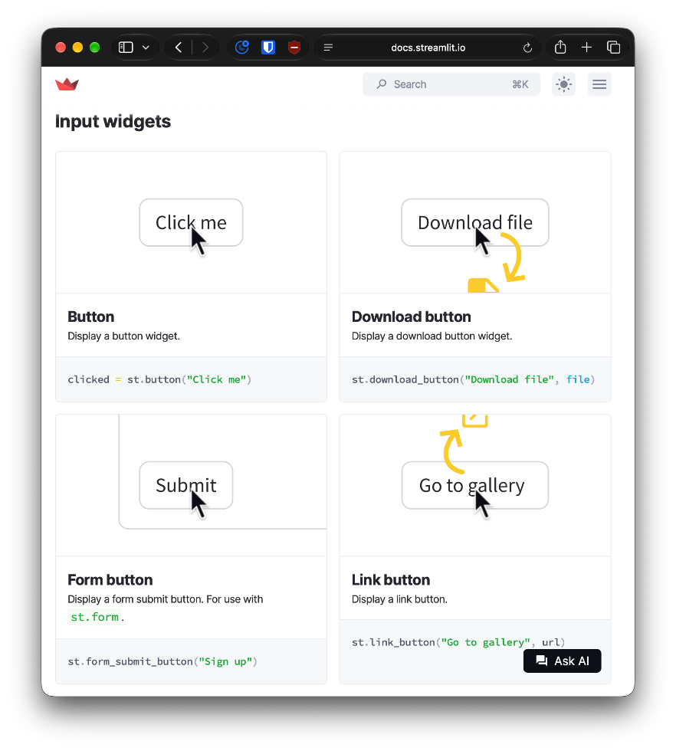
Components and Widgets
Gradio and Streamlit provide prebuilt user interface (UI) elements (e.g., buttons, sliders, and text inputs) to help you quickly build interactive Python apps:
  Gradio Components
  Streamlit Elements/Widgets
Notes:
Sources:
https://gradio.app/guides/sharing-your-app

Slide 7
Serving
Gradio provides easy serving without web hosting
You can open your app locally using the default port, 7860:
  http://127.0.0.1:7860
  http://localhost:7860
Adding share=True to launch() provides a temporary link, e.g., 60de1eaeaeb5f2b135.gradio.live/
You must keep your computer running so others are able to load your app in their browser
Notes:
Sources:
https://gradio.app/guides/sharing-your-app

Slide 8
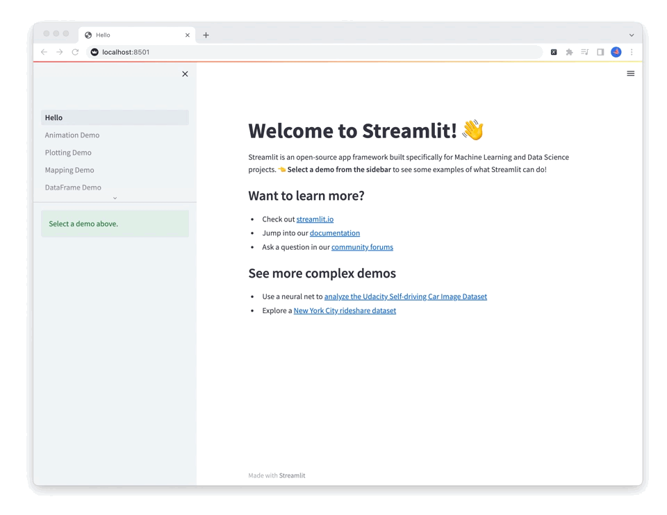
Gradio vs. Streamlit vs. …
Gradio is one Python-based option, and Streamlit is another
Both have their pros and cons, and each is better at some tasks vs. others
  Chatbots, RAG apps, model interfaces, etc.
Ultimately, use whatever you think works (or looks) best for your task (and explore alternatives)
Notes:
Sources:
https://gradio.app/guides/sharing-your-app

Slide 9
Incorporating APIs

Slide 10
Application Programing Interface (API)
Application programming interfaces (APIs) provide a structured way for software applications to talk to each other
Your app sends a request and receives a response
We’ll use APIs to allow our apps to do things like:
  Talk to large language models (LLMs) to generate text, power chatbots, classify data, etc.
  Interpret or generate images
  Transcribe or generate audio/video
  Search the web via search APIs or tools

Slide 11
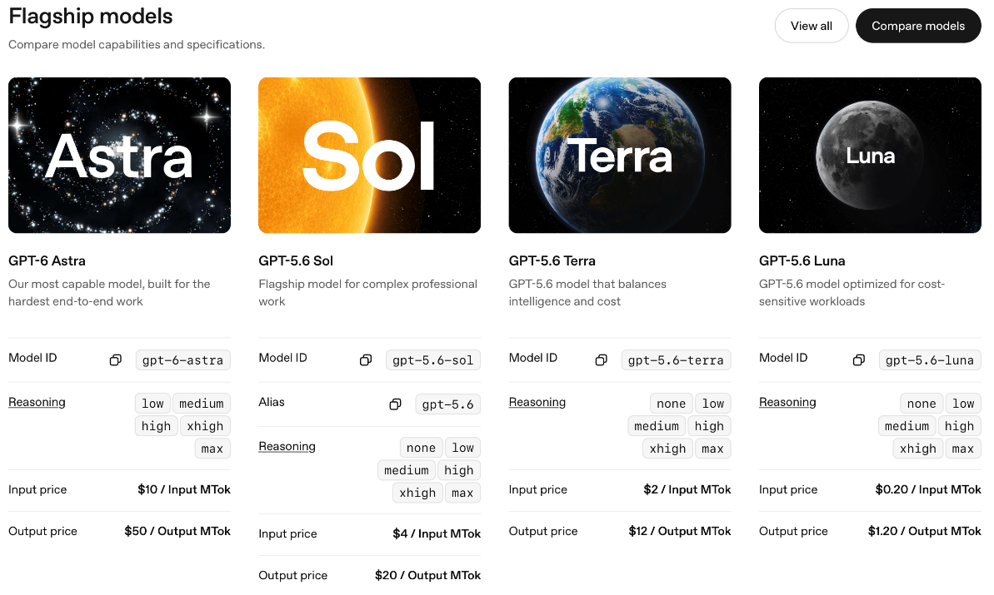
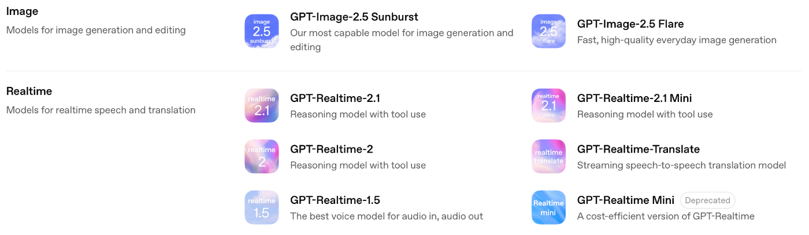
OpenAI API
For example, OpenAI provides developers an API Platform with all kinds of models
You pay per request (e.g., input/output price per million tokens, or MTok)
The OpenAI Python API library is one way to connect
Notes:
Sources:
https://developers.openai.com/api/docs/models

Slide 12
OpenAI-Compatible Endpoints
The OpenAI Python API library is designed to work with OpenAI models, but you can also use it to talk to OpenAI-compatible endpoints
These endpoints communicate the same way as the official OpenAI API Platform, but can be hosted elsewhere
For example, we are already using a free, OpenAI-compatible endpoint for our class LLM (served via vLLM):
  Base URL: http://dobolyi.com:9000/v1
  API Key: removed
  Model Name: DeepSeek-V4-Flash-0731
Notes:
Notes:
URL: Uniform Resource Locator

Slide 13
More Endpoints
Throughout this class, I will provide more endpoints to help with various tasks
For example, here is a new endpoint we can use for augmenting vision and for classification tasks:
  Base URL: http://dobolyi.com:9001/v1
  API Key: removed
  Model Name: cyankiwi/Qwen3.6-35B-A3B-AWQ-4bit
We’ll also talk about models for embeddings, multimodal generation, etc. in future classes
Notes:
curl http://dobolyi.com:9001/v1/chat/completions \
-H "Authorization: Bearer removed" \
-H "Content-Type: application/json" \
-d '{
"model": "cyankiwi/Qwen3.6-35B-A3B-AWQ-4bit",
"messages": [
{"role": "system", "content": "You are a helpful assistant."},
{"role": "user", "content": "Explain quantum computing in one sentence."}
],
"temperature": 0
}'

Slide 14
Debugging

Slide 15
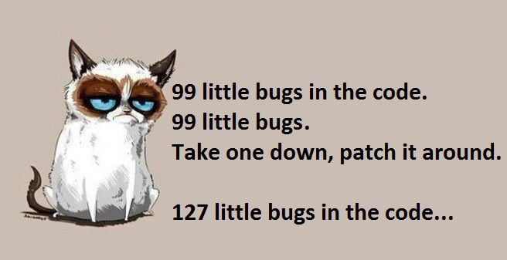
Bugs and Bug Reports
While you build and test your app, your code will invariably contain bugs, which are errors in the software that cause it to fail or not work as intended
To fix bugs, you need to create a thorough bug report, which helps document, reproduce, and ultimately fix each issue
Warning! Just because an agent says a bug was fixed doesn’t mean it’s true! You must check!
Notes:
Sources:
https://www.reddit.com/r/ProgrammerHumor/comments/1s2tf6/pic_i_made_for_our_inhouse_programmer_thought_you/

Slide 16
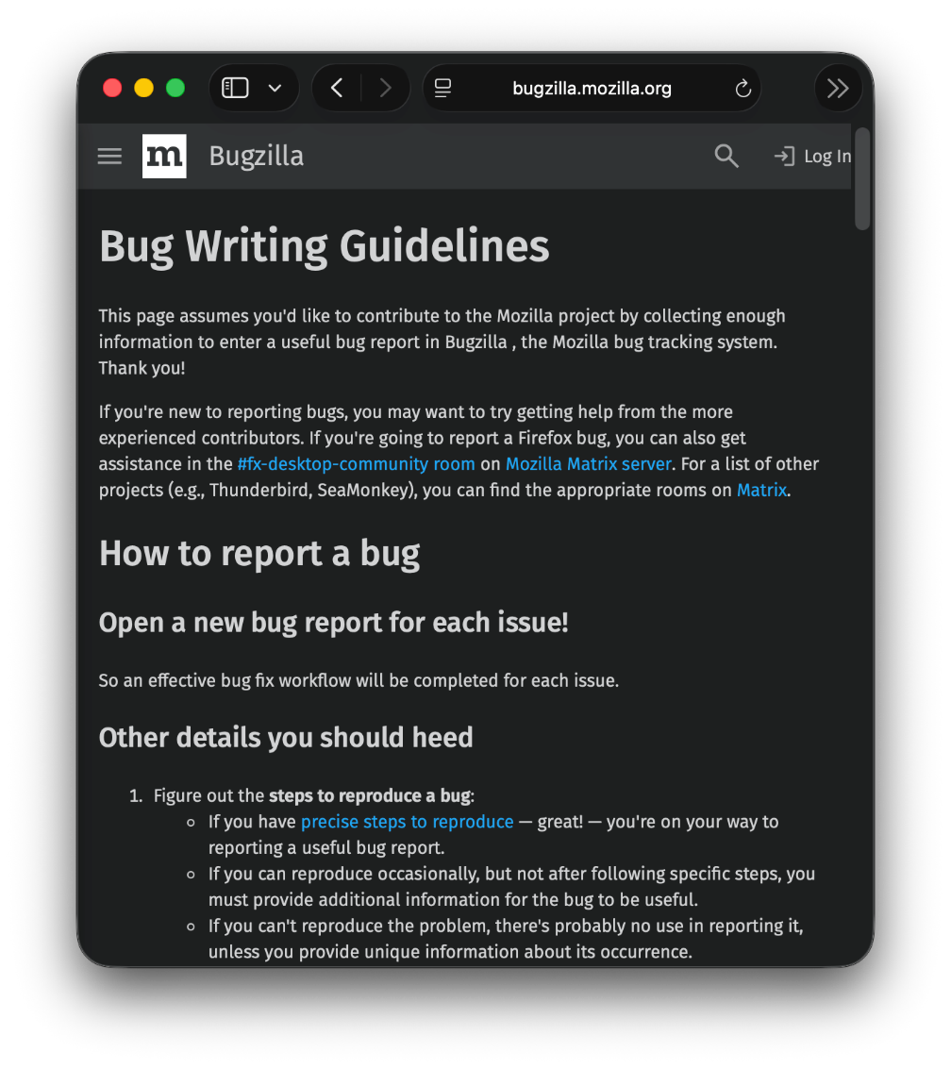
Writing Useful Bug Reports
Key Questions
  What is the problem?
  Where in the app does it happen?
  What did you expect to happen?
  What actually happened?
  How do you reproduce it?
Supporting Evidence
  Was there an error message?
  Can you provide a screenshot?
  Does it happen every time or only sometimes?
Notes:
Sources:
https://bugzilla.mozilla.org/page.cgi?id=bug-writing.html
https://developer.apple.com/news/?id=vvrgkboh

Slide 17
Working with Hermes to Fix Bugs
Provide each bug report to Hermes and ask for a targeted, testable fix
Verify every fix by trying your reproduction steps: no matter what Hermes claims, test, retest, and test again
Check related features: fixing one bug can introduce others
To make repeated testing easier, consider asking Hermes for automated tests (as opposed to your own manual tests), including:
  Unit tests – tests for small, specific parts of your software
  Smoke tests – quick/inexpensive tests that ensure your app starts/runs and the basic functions work
  End-to-end tests – perform and verify a complete workflow
Notes:
Sources:
https://www.atlassian.com/continuous-delivery/software-testing/types-of-software-testing

Slide 18
GitHub

Slide 19
What is GitHub?
GitHub’s first Start Your Journey tutorial asks, “What is GitHub?”:
  “GitHub is a platform that supports your entire software development process, from planning work to deploying and operating software.”
GitHub is built on the open-source version control system called Git, which records changes to project files
We’ll use Git and GitHub primarily to:
  Manage our code
  Recover earlier versions
  Collaborate with others
All of this will happen inside a repository (or repo), which stores a project’s files, its history, privacy/collaboration settings, etc.
Notes:
Sources:
https://docs.github.com/en/get-started/start-your-journey
https://docs.github.com/en/get-started/start-your-journey/what-is-github

Slide 20
Working with GitHub
Before creating a repo on GitHub, you need an account:
  https://github.com/signup
With an account, you can create your first repo via the website or locally using the GitHub Desktop application (which you can later push to GitHub)
Or just ask Hermes:
  “Help me connect to my GitHub account”
  “Create and connect a new GitHub repo for this project before we begin”
Notes:
Sources:
https://docs.github.com/en/get-started/start-your-journey/creating-a-repository-for-your-project-on-github

Slide 21
Hermes and GitHub
If you ask it to (e.g., “Let’s use GitHub for version control”), Hermes will take care of Git/GitHub on your behalf, including common commands:
  git init – create a new local repository
  git clone – copy an existing repository to your computer
  git status – show local changes and what’s ready to commit
  git add – select changes to include in the next commit
  git commit – record selected changes as a checkpoint
  git push – send commits to a remote repository, e.g., GitHub
  git revert – create a new commit that reverses a previous commit
  git pull – retrieve/incorporate remote changes to your local copy
  git diff – compare changes between file versions

Slide 22
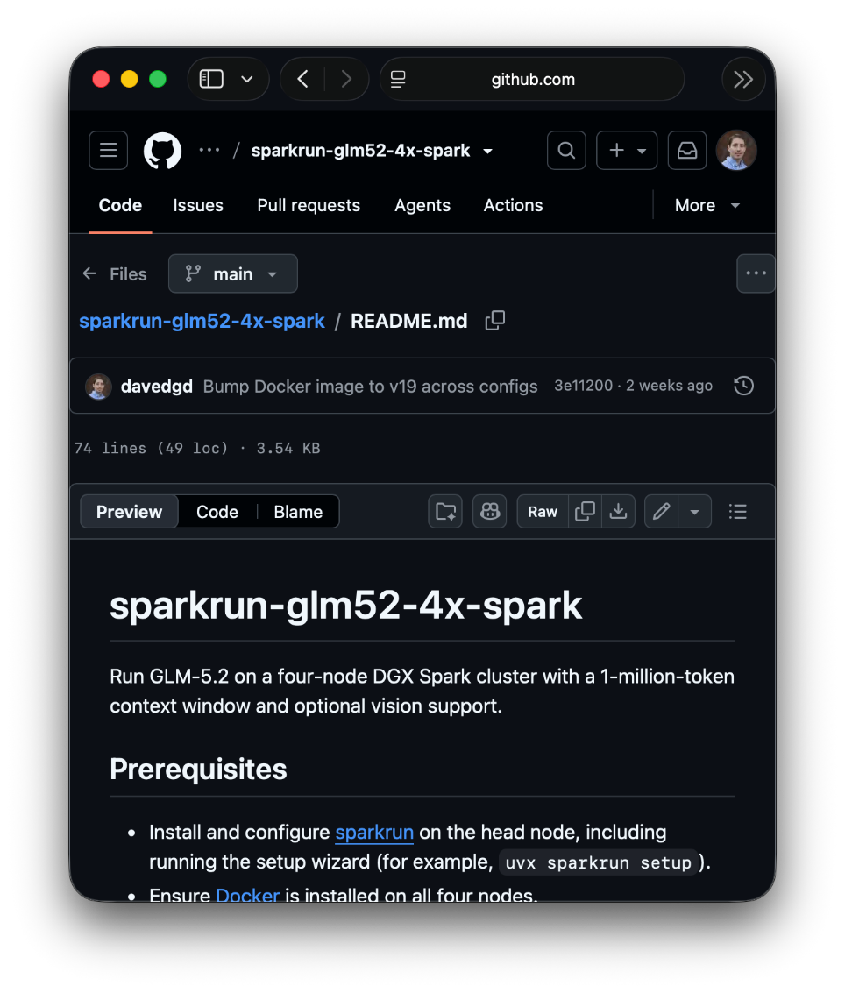
README.md
When you create a repo or make your first commit, include a README.md, which describes the project, how to set it up, and how to use it
Update this file as your project changes
Hermes will typically create this file for you, but you can also ask it to directly:
  “Create a README.md explaining this project and how to use it”

Slide 23
Commits
Ask Hermes to create a commit with each meaningful change and consider grouping related changes into checkpoints, especially when debugging or experimenting with user interface (UI) styling:
  “Review these changes and commit them with a clear summary”
Hermes will write commit messages for you which include:
  Summary (Subject) – a summary of changes (50 characters or fewer recommended)
  Description (Body) – optional details of what changed and why
Ask Hermes to push regularly, or specify when to wait:
  “Push all of the latest commits” or…
  “Hold off on pushing until I say so”

Slide 24
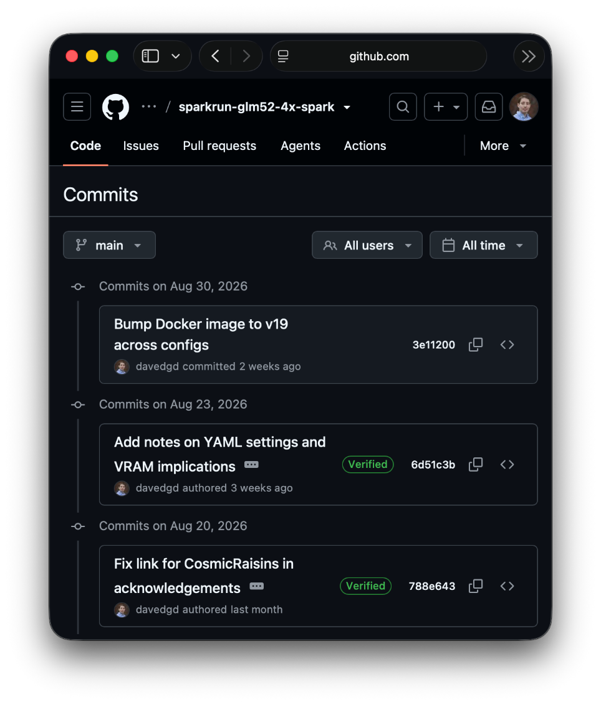
Reverting Commits
Commits are useful for tracking and recovering from mistakes
If a new bug appears, work with Hermes to review your commit history on GitHub to help identify which change introduced it
Ask Hermes to revert the relevant commit, undoing the changes:
  “This worked before the last commit: find and undo what broke it”
Test again to confirm the problem is actually resolved

Slide 25
Branching and Merging
Use branch to create separate lines of work in a repo to safely:
  Develop a new feature
  Fix a bug
  Experiment
The default branch is typically called main, and it holds the primary version you build from
You can create and name other branches (e.g., dev)
Use merge to combine changes across branches (e.g., dev into main)
Ask Hermes:
  “Create a branch for this feature and test it before merging into main”

Slide 26
Collaboration: Issues and PRs
Create issues to provide a record of tasks, discussions, and progress, giving you, collaborators, and Hermes useful context
Create pull requests (PRs) to propose changes you want to merge (e.g., fixes to issues), allowing for review, discussion, and tracking
  Collaborators can suggest revisions before you merge
Ask Hermes:
  “Create an issue from this bug report”
  “Open a pull request for this feature and summarize the changes and testing”

